Slide 1
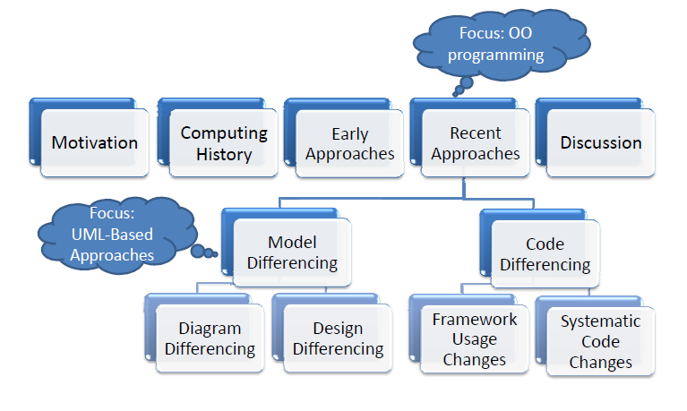
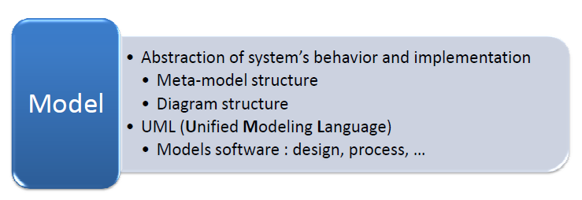
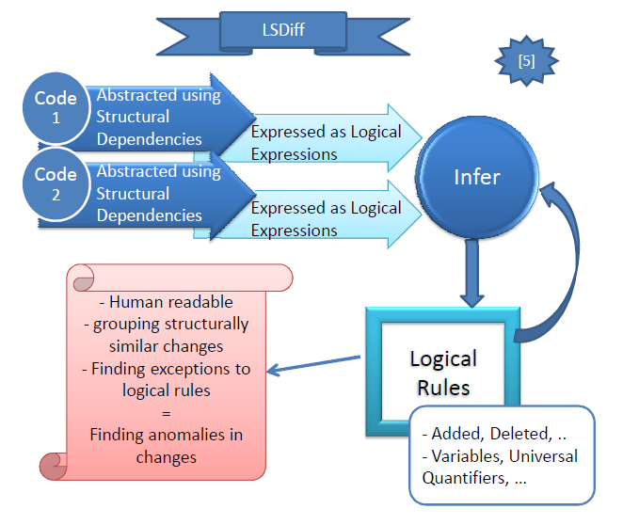
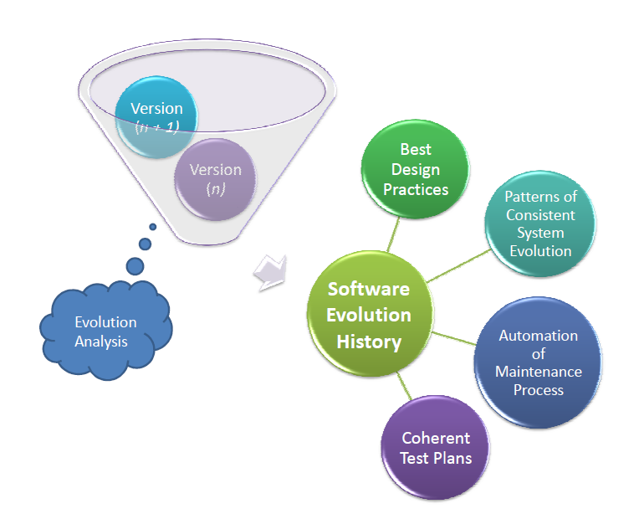
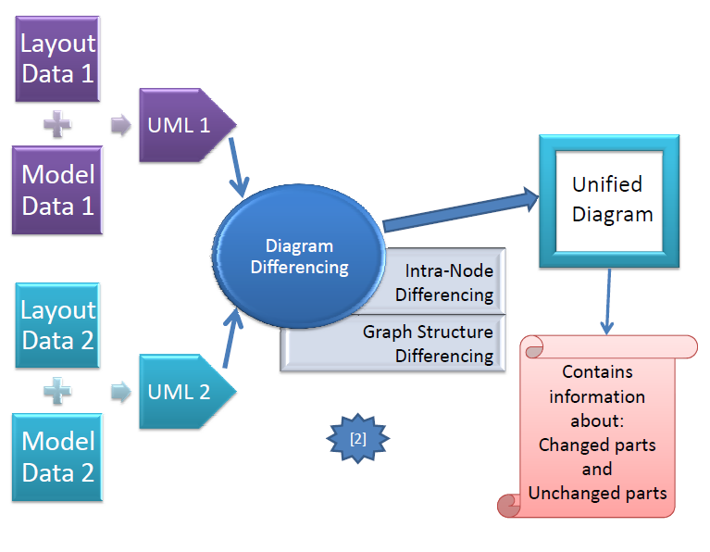
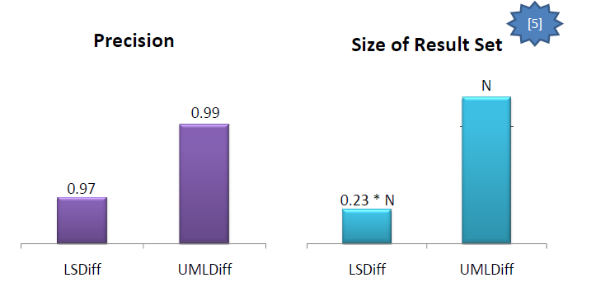
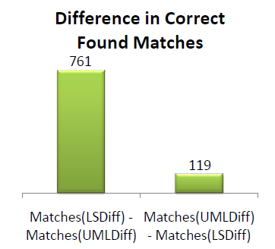
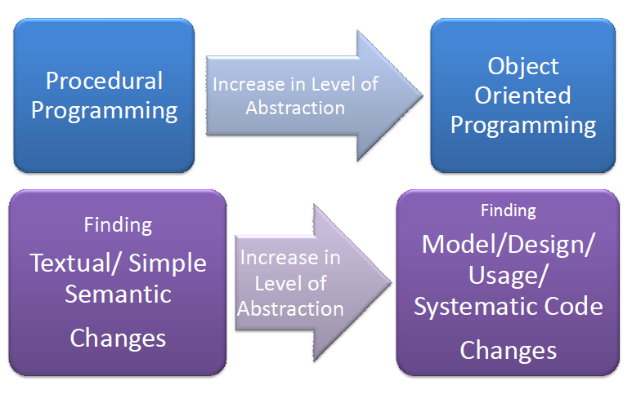
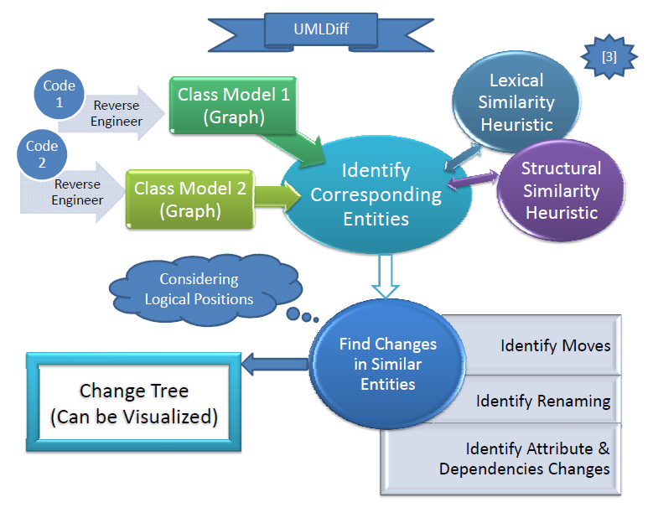
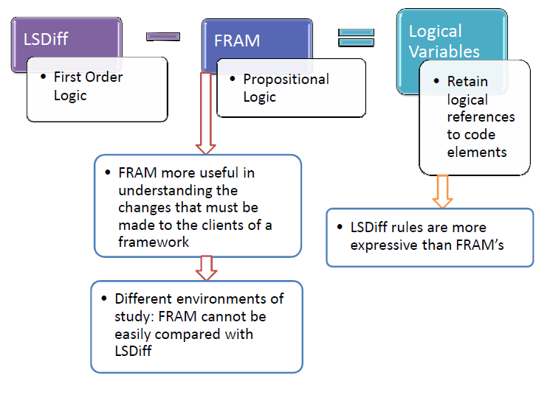
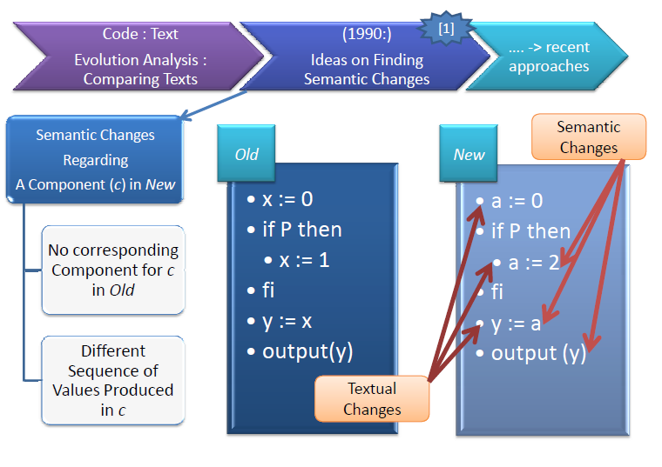
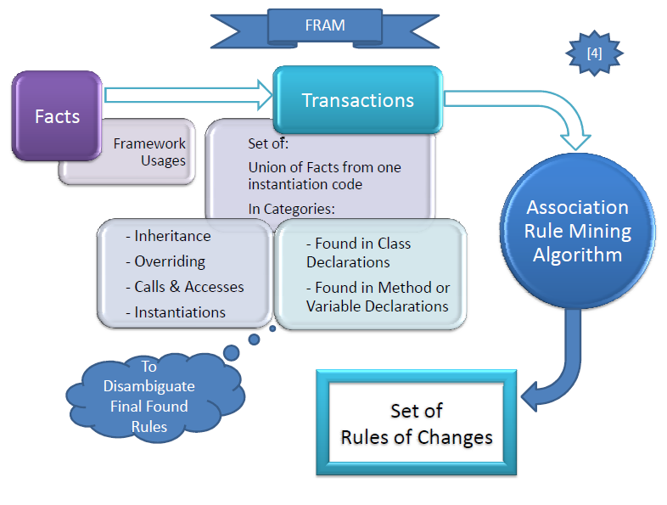
Supporting Software Development Process Using Evolution Analysis
Samaneh Bayat Department of Computing Science, University of Alberta, Edmonton, Canada
samaneh@ualberta.ca
OPTIONAL LOGO HERE
Overview
Recent Approaches
Systematic Code Changes
Model Differencing
Diagram Differencing
Motivation
Discussion
Computing History
Design Differencing
Early Approaches
Code Differencing
Framework Usage Changes
References
[1] Susan Horwitz. Identifying the semantic and textual differences between two versions of a program. In PLDI ’90: Proceedings of the ACM SIGPLAN 1990 conference on Programming language design and implementation, pages 234–245, New York, NY, USA, 1990. ACM.
[2] Dirk Ohst, Michael Welle, and Udo Kelter. Differences between versions of UML diagrams. In ESEC/FSE-11: Proceedings of the 9th European software engineering conference held jointly with 11th ACM SIGSOFT international symposium on Foundations of software engineering, pages 227–236, New York, NY, USA, 2003. ACM.
[3] Zhenchang Xing and Eleni Stroulia. Umldiff: an algorithm for object-oriented design differencing. In ASE ’05: Proceedings of the 20th IEEE/ACM international Conference on automated software engineering, pages 54–65, New York, NY, USA, 2005. ACM.
[4] Thorsten Schafer, Jan Jonas, and Mira Mezini. Mining framework usage changes from instantiation code. In ICSE ’08: Proceedings of the 30th international conference on Software engineering, pages 471–480, New York, NY, USA, 2008. ACM.
[5] Miryung Kim and David Notkin. Discovering and representing systematic code changes. In ICSE ’09: Proceedings of the 2009 IEEE 31st International Conference on Software Engineering, pages 309–319, Washington, DC, USA, 2009. IEEE Computer Society.

